Slide 1

Mitigating transient execution attacks with focus on performance-security tradeoff
Sumon Nath (21q050007) guided by Prof. Biswabandan Panda sumon@cse.iitb.ac.in

Slide 2

Problem overview
Retpoline^{[2]}
Non-speculative load barrier
LFENCE instructions
GhostMinion
[1]
Claims to have minimum performance overhead
Significantly degrades performance of modern hardware prefetchers
[1] P. Kocher, J. Horn, A. Fogh, , D. Genkin, D. Gruss, W. Haas, M. Hamburg, M. Lipp, S. Mangard, T. Prescher, M. Schwarz, and Y. Yarom. Spectre attacks: Exploiting speculative execution. In S&P, 2019
[2] P. Turner. Retpoline: a software construct for preventing branchtarget-injection. https://support.google.com/faqs/answer/ 7625886, 2018.

Slide 3
GhostMinion^{[MICRO ‘21]}
Stores all speculative data
Writeback to L1D on commit
Wiped on context switch
Strictness ordering
DRAM
LLC
L2
L1D
GM
CPU

Slide 4
Data flow in caches
DRAM
DRAM
LLC
LLC
Evict
L2
L2
Evict
L1D
commit
GM
L1D
CPU
CPU
Normal Cache hierarchy
GhostMinion

Slide 5
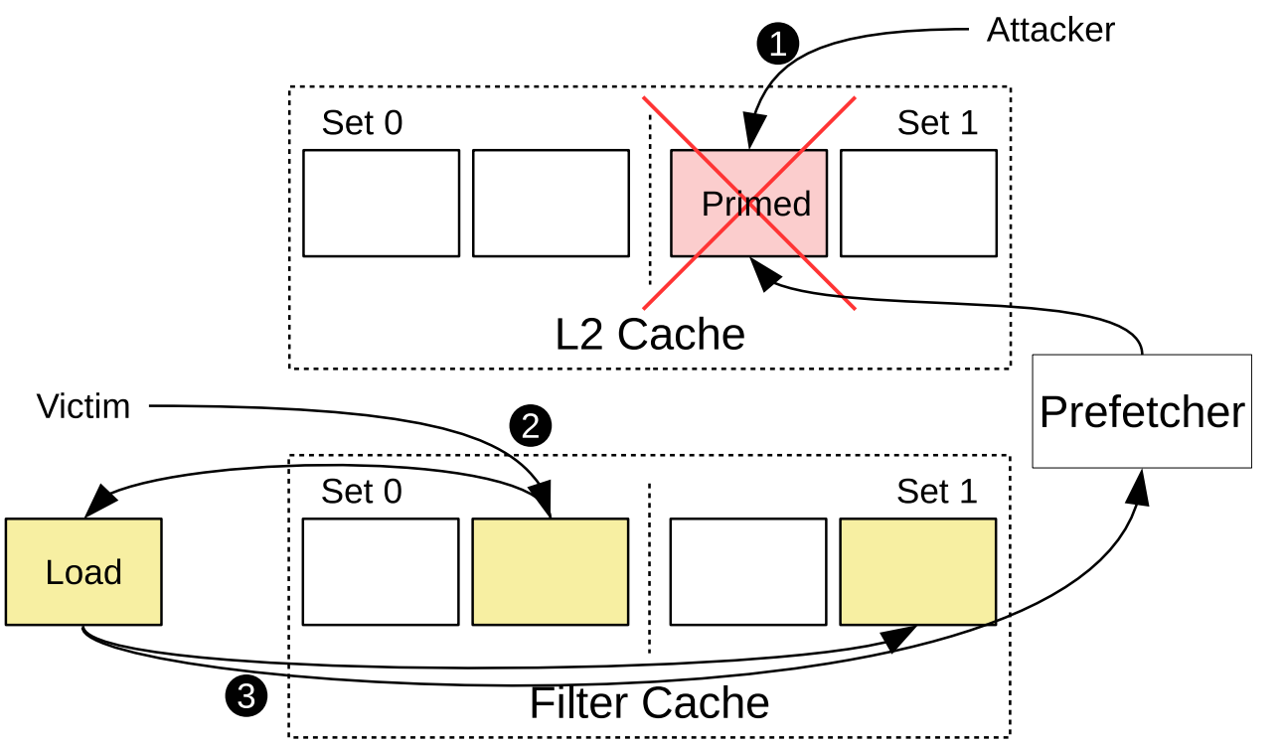
Attack through prefetchers

Slide 6
Prefetching restrictions
GhostMinion
Speculative prefetching to filter cache
On-commit prefetching
Non-secure
Trained and triggered with speculative data
Filled into L0 cache
Trained and triggered with committed data
Filled into non-spec cache
Trained and triggered with speculative data
Filled into non-spec cache

Slide 7
Prefetching performance in GhostMinion
Speculative (GM)
On-commit (GM)
On-commit (GM)
Performance improvement
Bert has highest performance
Still 17% gap with vanilla Berti
High performance degradation
Cache pollution
Pressure on microarchitecture structures
Performance improvement
Bert has highest performance
Still 18% gap with vanilla Berti

Slide 8
Possible cause of performance drop?
On-commit prefetch restriction
GhostMinion cache hierarchy

Slide 9
On-commit prefetching in non-secure system
On-commit(Non secure)
Marginal performance drop compared to Vanilla config.
On-commit, not primary reason for performance drop in GM.

Slide 10
Performance analysis
IP-stride prefetcher : simple
Berti : complex

Slide 11
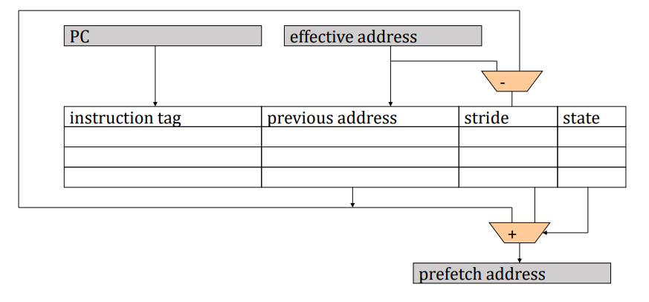
IP-stride prefetcher

Slide 12
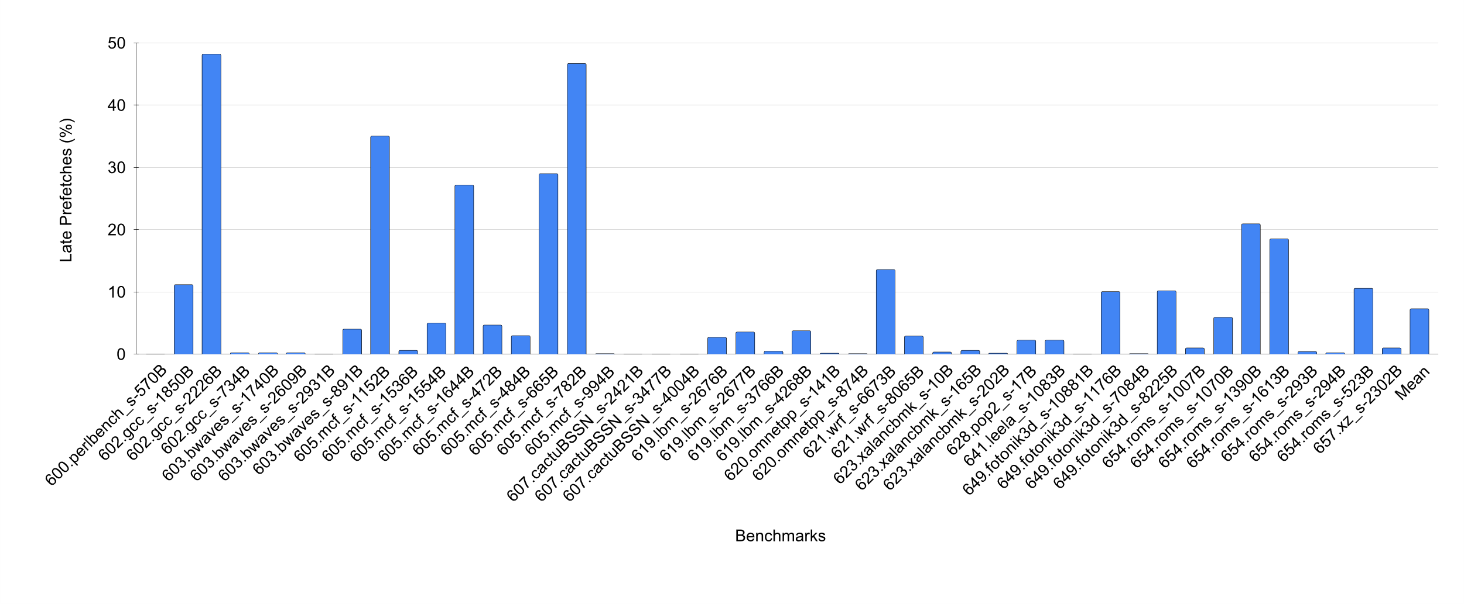
Lateness in IP-stride (non-secure)
Overall lateness 7%

Slide 13
Lateness in on-commit prefetcher
Commit Late
prefetch would be timely if triggered on speculative access
Commit late MSHR
Prefetch in MSHR, would be timely if triggered on speculative access

Slide 14
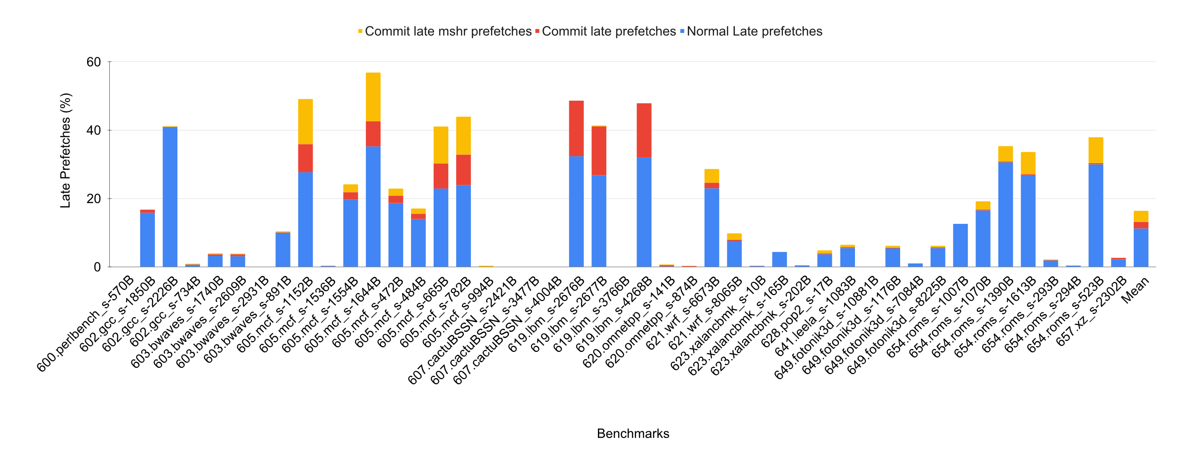
Lateness in on-commit IP-stride(GM)
Overall lateness increases to 11%

Slide 15
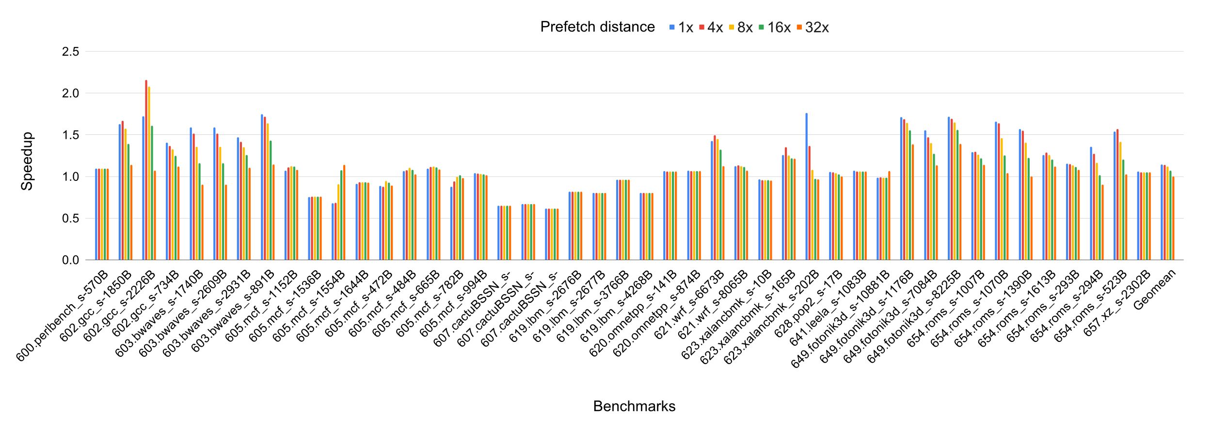
Lateness in IP-stride
gcc, mcf, xalancbmk, wrf improves performance with higher prefetch distance
Overall performance degrades with higher prefetch distance

Slide 16
Berti^{[MICRO ‘22]} prefetcher
Accurate and timely local delta L1D prefetcher
.
.
.
.
.
.
@2
@5
@7
@10
@12
@15
timeline
Goal: find a delta that can trigger a timely prefetch for @15
deltas: +8, +5, +3

Slide 17
Berti prefetcher
Accurate and timely local delta L1D prefetcher
.
.
.
.
.
.
@2
@5
@7
@10
@12
@15
timeline
Time to fetch @15 (latency)
Timely deltas: +13, +10

Slide 18
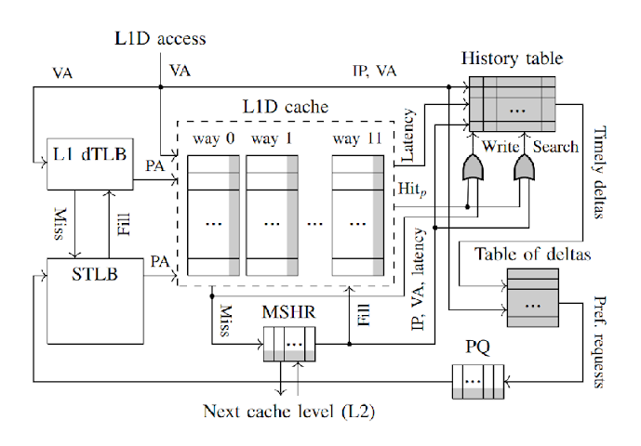
Berti hardware extensions
Stores access time of misses
Stores deltas based on IPs to trigger prefetches
Calculates latency on fill

Slide 19
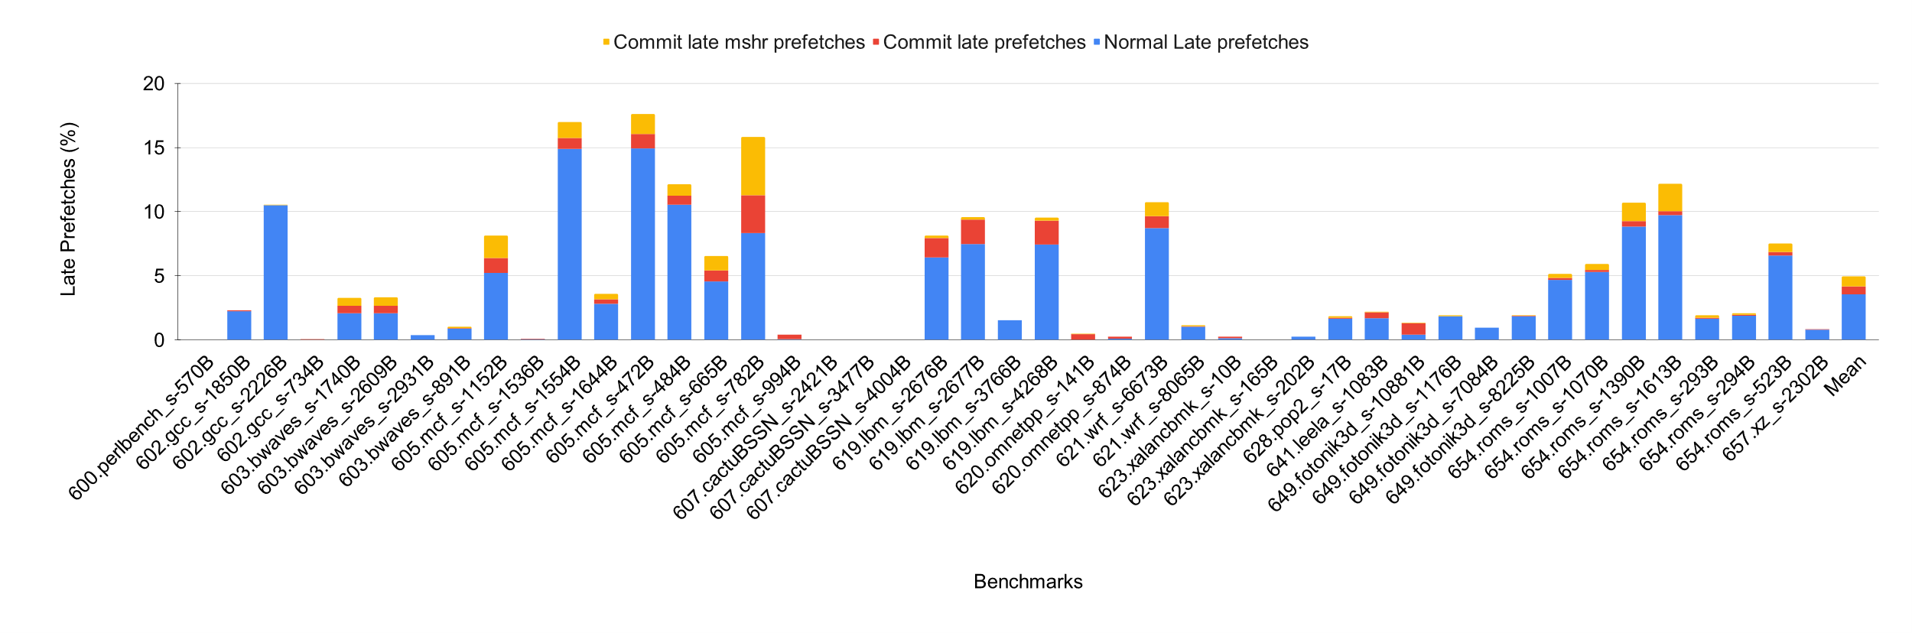
Lateness in Berti
Overall lateness increases by 3% compared to non-secure system

Slide 20
Timeliness and prefetcher accuracy
Both Timeliness and prefetcher accuracy drops in on-commit(GM) version

Slide 21
Modifying Berti
Timely delta: +10
.
.
.
.
.
.
.
.
@2
@5
@10
C2
C10
@12
C10
F12
0
30
40
50
90
110
120
160
time
Fill latency = 50
Time to fetch @12

Slide 22
Hardware extensions
ROB is extended to store:
Access time
Hit/miss flag
Prefetch flag
Berti is trained at the time of commit using the information stored in extended ROB

Slide 23
Performance improvement with modified Berti
Marginal improvement of 1% with modified Berti

Slide 24
Filtering prefetching requests
DRAM
Key points:
Blocks evicted and filled from L1 to L2
if hit in L1 no need to issue prefetch
LLC
Evict
L2
Evict
commit
GM
L1D
CPU
GhostMinion

Slide 25
Performance improvement with further modification
Improvement of 2% compared to unmodified Berti

Slide 26
Cause of performance drop
On-commit prefetch restriction
GhostMinion cache hierarchy

Slide 27
Current and ongoing work
We can conclude that prefetching restrictions is not the major contributor to performance degradation in a secure system.
We get a marginal improvement of 2% with modification to the Berti prefetcher to work in an on-commit setting.
GhostMinion’s modifications to the flow of data in the cache hierarchy is root cause of performance loss.
We are looking into further ideas to improve the GM hierarchy.
We can make a case that our prefetcher can recover the performance loss by secure cache hierarchies?

Slide 28
Acknowledgements
Thanks to Prof. Alberto Ros and Agustin Navarro-Torres for their collaboration and contributions to this work.

Slide 29
Thank You

